Slide 1
Binary Logic
J.Saira Banu

Slide 2
Integrated Circuits
A small silicon semiconductor crystal called a chip, containing electrical components such as transistor, diodes, resistors and capacitors.
SSI (Small Scale Integration)<10 transistors
- gates
MSI (Medium Scale Integration) 10 to 100
  - Decoders, adders, Multiplexers
LSI (Large Scale Integration)>100
- processors, memory chips and PLD’s(programmable Logic device)
VLSI (Very Large Scale Integration) -1000
- large memory arrays, complex microcomputer chips
J.Saira Banu

Slide 3
Binary Logic
Two discrete values
  True or false
  Yes or no
  0 or 1
Describes the mathematical way, the manipulation and processing of binary information.
J.Saira Banu

Slide 4
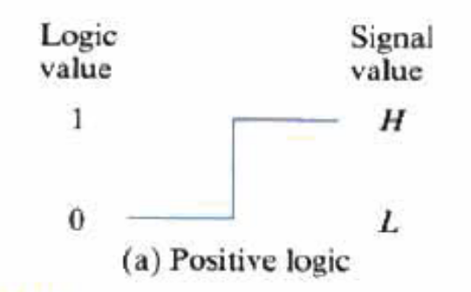
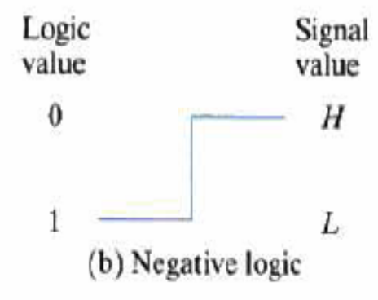
Positive and negative logic
Positive logic: High-level H represents logic – 1.
Negative Logic: Low level L represents logic – 1.

Slide 5
Logic Gates
Basic Gates
  AND
  OR
  NOT
Universal Gates
  NAND
  NOR
Special Gates
  X-or
  X-Nor
J.Saira Banu

Slide 6
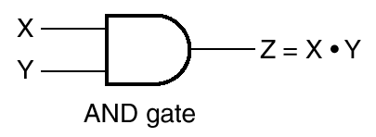
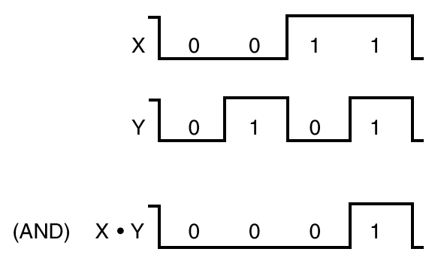
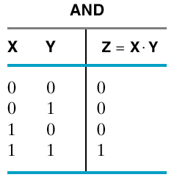
AND Gate
Symbol is dot
  C = A · B
Or no symbol
  C = AB
C is 1 only if
  Both A and B are 1
J.Saira Banu

Slide 7
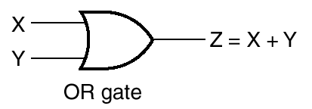
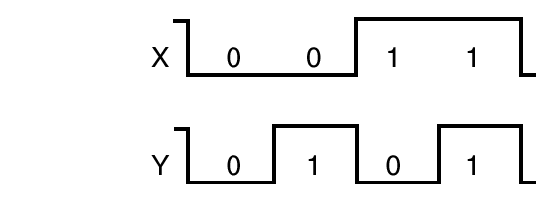
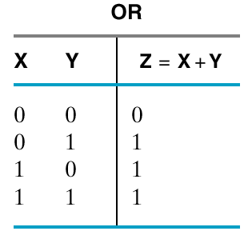
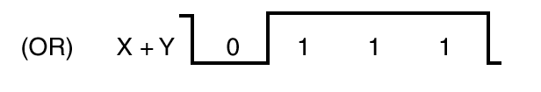
OR Gate
Symbol is +
  Not addition
  C = A + B
C is 1 if either 1
  Or both 1
J.Saira Banu

Slide 8
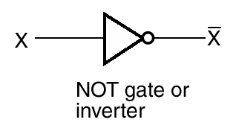
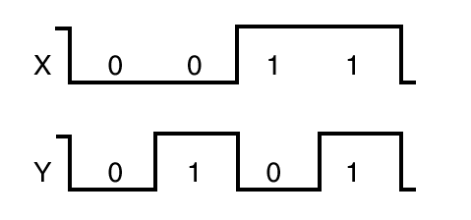
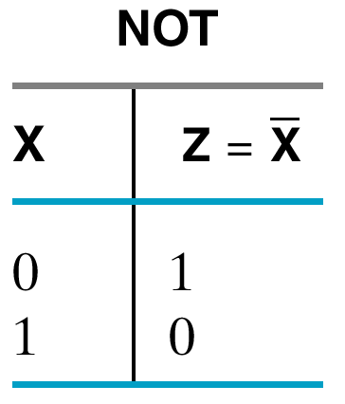
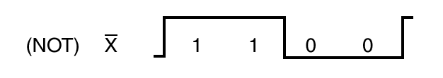
NOT Gate
Unary
Symbol is bar
  C = Ā
Inversion
J.Saira Banu

Slide 9
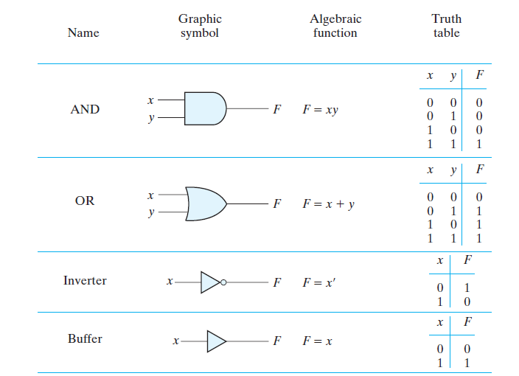
Logic Gates
J.Saira Banu

Slide 10
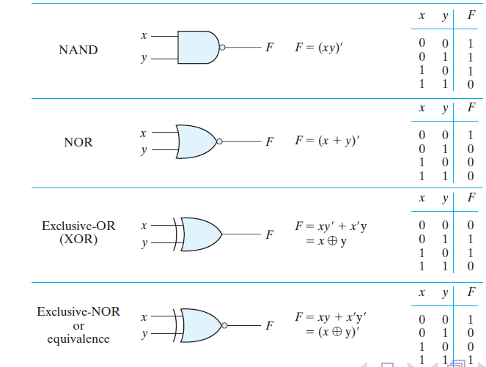
Logic Gates
J.Saira Banu

